Slide 1
Introduction to SharePoint Designer
The Ultimate Power Tool for
Customizing a SharePoint site

Slide 2
Agenda
Introduction to SharePoint Designer
Creating and Customizing Pages
Working with Master Pages
Creating Pages with the DataView Web Part
Configuring Security with SPD

Slide 3

SharePoint Designer (SPD)
Next version of FrontPage 2003
SharePoint-specific version for solutions builders
SPD split apart from new Expressions suite
Enables four fundamental usage scenarios
Customize SharePoint sites
Assemble composite applications that pull data from multiple sources
Build workflow applications and add application logic
Create page templates for WCM (MOSS only)

Slide 4
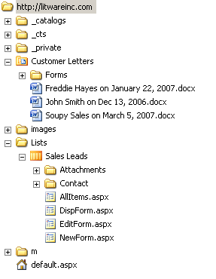
The Virtual File System of a Site
Site is a virtual file system
made up of folders and files
Pages are files
Documents are files
Stored in content database
How can you look at it?
SharePoint Designer (SPD)
Windows Explorer
SPD uses WebDav protocol for access

Slide 5
Site Pages Versus Application Pages
Site Pages exist within virtual file system of site
They may or may not be ghosted
They support customization via Web Parts
They support customization via SharePoint Designer
They can be added dynamically within a site
Customized pages impact performance and security
Application Pages are deployed once per farm
They do not support customization or Web Parts
They are parsed/compiled as classic ASP.NET pages
They cannot be added nor modified with SPD

Slide 6
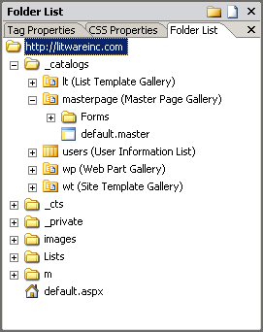
Opening a Site with SPD
Provides access to virtual file system
You can see and open files for editing
You can drag-and-drop to add new files

Slide 7
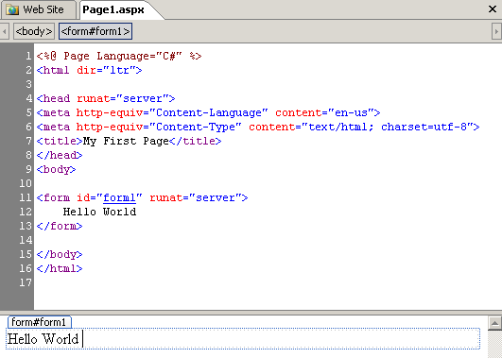
ASP.NET Pages
.aspx are parsed/processed by ASP.NET runtime
Provide more functionality than .htm files
Provide support for server-side controls

Slide 8
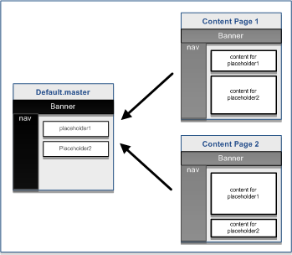
ASP.NET Background: Master Pages
ASP.NET 2.0 introduces Master Pages
Defines common layouts used across content pages

Slide 9
Master Page Defined in ASP.NET
<!-- default.master -->
<%@ Master %>
<html><body>
<form id="frmMain" runat="server">
<table width="100%">
<tr><td> <h1>Litware Inc.</h1><hr /></td></tr>
<tr>
<td> <!-- Display Main Body of Page -->
<asp:contentplaceholder id="PlaceHolderMain" runat="server" />
</td>
</tr>
</table>
</form>
</body></html>
<!-- content page linking to default.master -->
<%@ Page Language="C#" MasterPageFile="~/default.master" Title="Page 1" %>
<asp:Content ID="Main" ContentPlaceHolderID="PlaceHolderMain">
Unique page content goes here
</asp:Content>

Slide 10
Master Pages in WSS
Application pages use application.master
Farm-wide master page
Cannot be customized on per-site basis
Site Pages use default.master by default
default.master is a page template
default.master instance created in Master Page Gallery
default.master can be customized on per-site basis
default.master can be replaced with different template

Slide 11
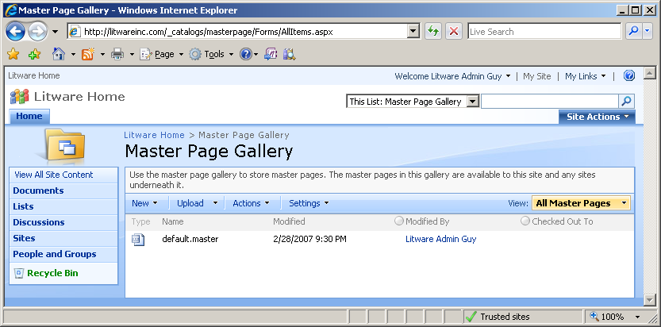
The Master Page Gallery
Each site has a Master Page Gallery
Instance of default.master automatically provisioned
default.master can be customized on per-site basis

Slide 12
Creating Pages using default.master
Commonly-used placeholders
PlaceHolderMain
PlaceHolderPageTitle
PlaceHolderPageTitleInTitleArea
PlaceHolderAdditionalPageHead
Less commonly used placeholder
PlaceHolderGlobalNavigation | PlaceHolderGlobalNavigationSiteMap | PlaceHolderSiteName
PlaceHolderSearchArea | PlaceHolderTopNavBar | PlaceHolderHorizontalNav
WSSDesignConsole | SPNavigation | PlaceHolderPageImage
PlaceHolderTitleLeftBorder | PlaceHolderTitleBreadcrumb | PlaceHolderMiniConsole
PlaceHolderTitleRightMargin | PlaceHolderTitleAreaSeparator | PlaceHolderLeftNavBarDataSource
PlaceHolderCalendarNavigator | PlaceHolderLeftNavBarTop | PlaceHolderLeftNavBar
PlaceHolderLeftActions | PlaceHolderNavSpacer | PlaceHolderLeftNavBarBorder
PlaceHolderBodyLeftBorder | PlaceHolderPageDescription | PlaceHolderBodyRightMargin
PlaceHolderFormDigest" | PlaceHolderUtilityContent | PlaceHolderBodyAreaClass
PlaceHolderTitleAreaClass

Slide 13
Adding Web Part Zones to a Page
Web Parts must go inside Web Part Zones
SPD allows you to add zones to pages
SharePoint uses zone ID to remember Web Part instances and their customization data

Slide 14
SharePoint’s use of CSS Files
All styles in WSS initially defined by core.css
Located in \TEMPLATE\LAYOUTS\1033\STYLES
Contains over 4000 lines of CCS class definitions
Classes used throughout standard WSS UI elements
Extending core.css
Applying WSS styles (meant for end users)
Applying custom CCS files (meant for developers)

Slide 15
Top Navigation Areas
ms-globalbreadcrumb
ms-globalleft
ms-globalright
ms-globallinks
ms-sitetitle
ms-globalTitleArea
ms-siteaction
ms-siteactionsmenu
ms-topNavContainer
ms-banner
ms-topnav + ms-topNavSelected
ms-bannerframe
ms-bannerContainer
ms-topnav

Slide 16
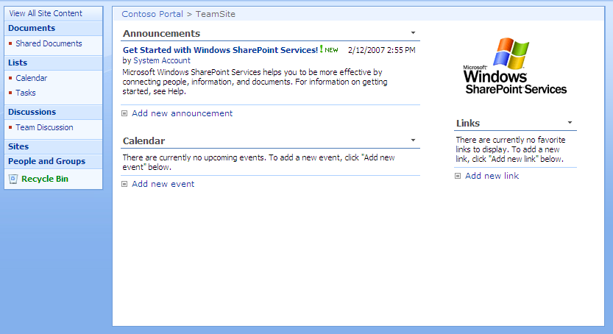
Body Structure
ms-titlearealeft
ms-pagetitleareaframe
ms-titlearearight
ms-titleareaframe
ms-pagetitle
ms-titleareaframe
ms-leftareacell
ms-navframe
ms-pagemargin
ms-pagebottommargin
ms-pagebottommarginright
ms-pagemargin
ms-pagebottommarginleft
ms-bodyareapagemargin
ms-rightareacell

Slide 17
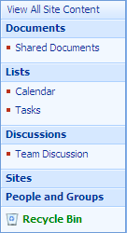
Quick Launch
ms-quicklaunchouter
ms-quickLaunch
ms-standardheader
ms-navSubMenu1
ms-quicklaunchheader
ms-navheader
ms-navSubMenu2
ms-navitem
ms-recyclebin

Slide 18
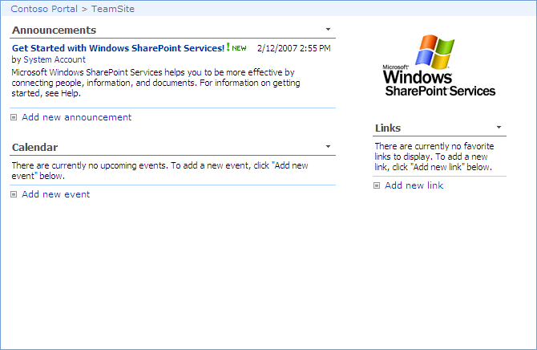
Page Body
ms-bodyareacell
ms-propertysheet
ms-pagebreadcrumb
ms-bodyareaframe
ms-sitemapdirectional

Slide 19
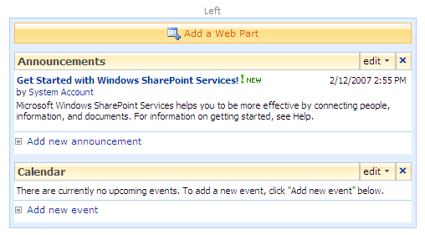
Web Parts
used in edit mode only
ms-SPZone
ms-SPZoneLabel
ms-HoverCellInActive
ms-SPButton ms-WPAddButton
ms-WPEditText
ms-WPHeader
ms-standardheader ms-WPTitle
ms-HoverCellInActive
ms-summarycustombody
ms-addnew
list view web part only
ms-vb

Slide 20
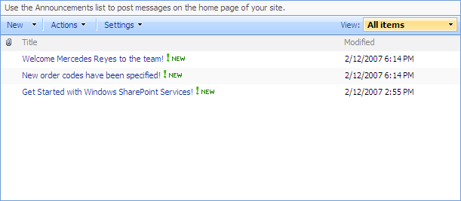
List Views
ms-listdescription
ms-menutoolbar
ms-viewselectorhover
ms-toolbar
ms-listheaderlabel
ms-vh-icon
ms-splitbuttonhover
ms-separator
ms-vh2
ms-unselectedtitle
ms-vb
ms-alternating
ms-vb-title
ms-unselectedtitle
ms-vb
ms-vb2

Slide 21
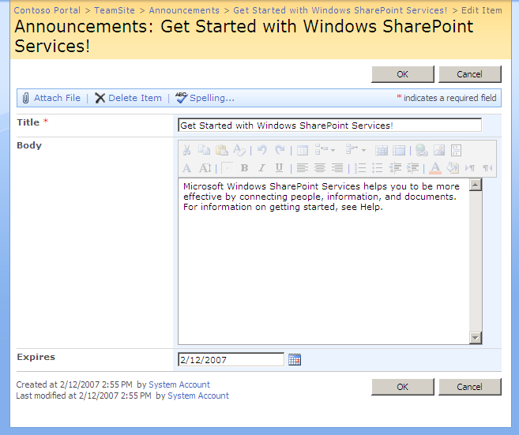
Forms
ms-areaseparatorleft
ms-areaseparatorright
ms-areaseparator
ms-titlearea
ms-pagetitle
ms-sitemapdirectional
ms-formtoolbar
ms-toolbar
ms-ButtonHeightWidth
ms-formtable
ms-formlabel
ms-formbody
ms-formtoolbar
ms-toolbar
ms-descriptiontext

Slide 22
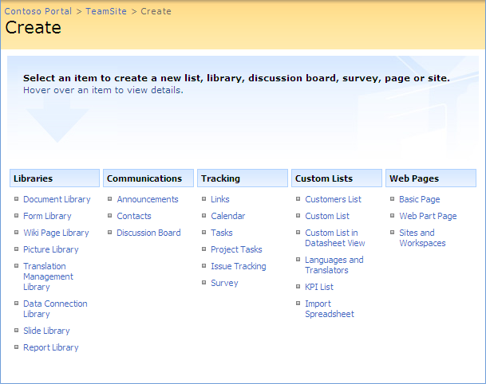
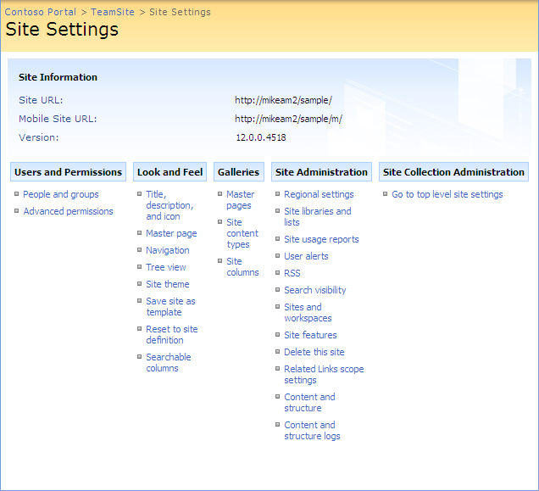
Application Pages (Landing Pages)
ms-settingsframe
ms-createpageinformation
ms-informationtablestatic
ms-pageinformation
ms-linksectionheader
ms-standardheader
ms-propertysheet
ms-descriptiontext

Slide 23
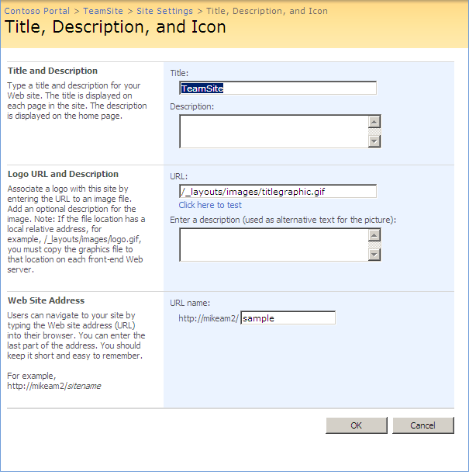
Application Pages (Form Pages)
ms-formareaframe
ms-propertysheet
ms-descriptiontext
ms-sectionheader
ms-standardheader
ms-descriptiontext ms-inputformdescription
ms-authoringcntrols ms-inputformcontrols

Slide 24
The DataView Web Part
DVWP connects to many types of data sources
SharePoint Lists
Databases through OLEDB (SQL Server, ORACLE, etc.)
Web Services and RSS Feeds
Provides WYSIWYG environment for creating display
Drag-and-drop fields from data source onto view
Automatically format fields (currency, date, etc)
Use conditional formatting
Use Web Part connections
SPD generates XSLT behind the scenes

Slide 25
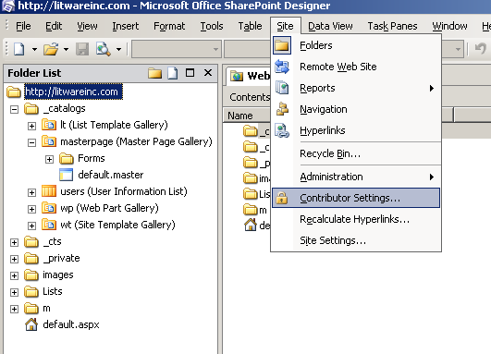
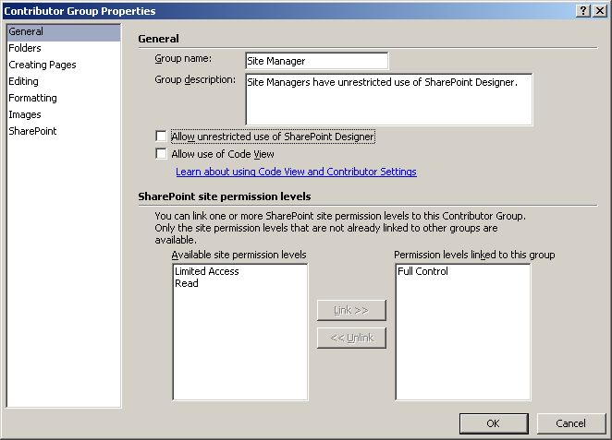
Control Access to SharePoint Objects

Slide 26
Summary
Introduction to SharePoint Designer
Creating and Customizing Pages
Working with Master Pages
Creating Pages with the DataView Web Part
Configuring Security with SPD

